Slide 1
Graph clustering and possible applications to power system data
Saurav Mohapatra
smohapa2@Illinois.edu
CS 512
Spring 2013

Slide 2
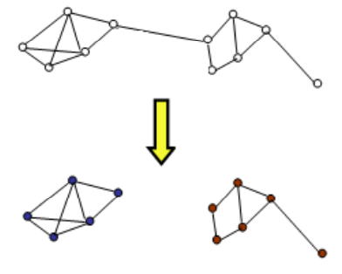
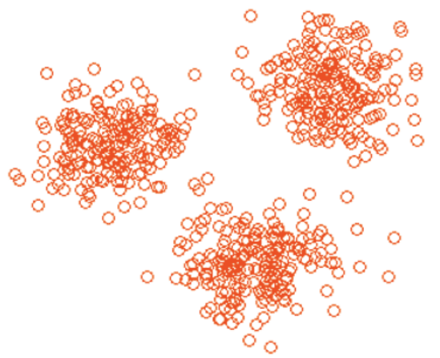
Clustering and Graph Clustering
2-D data points
Easy to see clusters
K-means (circular)
vs. Dbscan (any shape)
Natural have some network structure OR can be explained by generative graph model
Soft partitioning

Slide 3
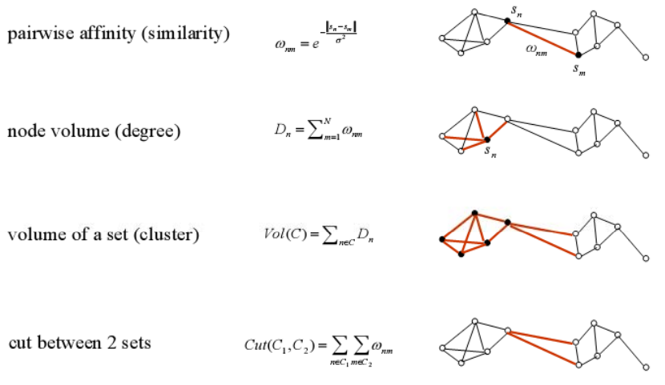
Some terminologies

Slide 4
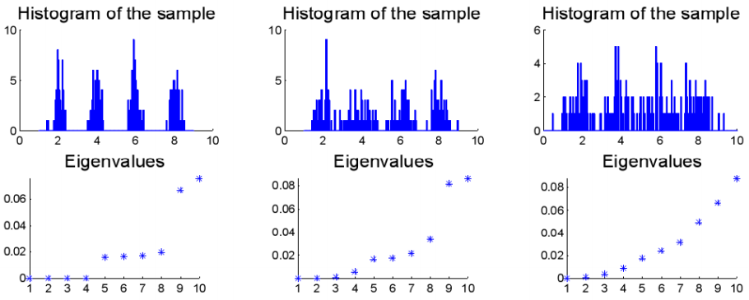
Eigenvalues of Laplacian matrix: L = I – A - more useful than just adjacency matrix

Slide 5
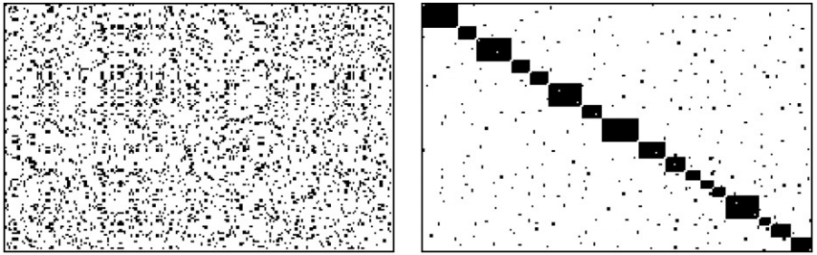
Importance of ordering of nodes
Randomly numbered nodes, vs. Some ordered arrangements
Important: These are sub-optimal
Global optimality is hard to prove for non-trivial cases
Close link with visualization

Slide 6
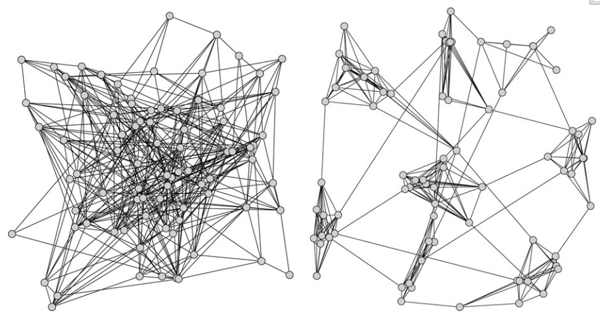
Generative models
Random uniform graph
Constant probability p of creating a edge between two nodes
Relaxed caveman graph
Need many more parameters than just probabilities, such as number of “caves”, their densities, relative separation, etc

Slide 7
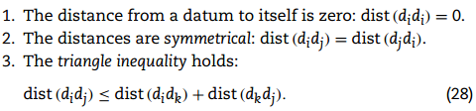
Similarity measures
Too many different kinds
L-1, L-2, L-infinity in Euclidian space
Jaccard coefficient
Depending on the dimension, and size of data set, many definitions can be made, for example: distance between top-k maximum entries for a vector dimension 100
However, these “rules” are usually abided by

Slide 8
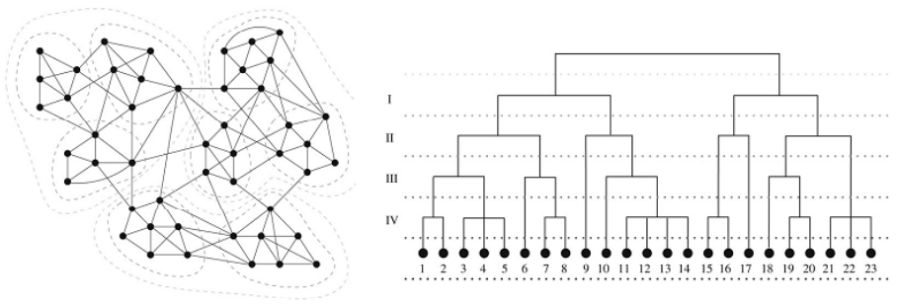
Global clustering – Hierarchical clustering
Top down
Break along minimum cut set, or some density measure
Bottom up
Group together nodes, with adjacent nodes until everything is one group
Need to use heuristics and parameter tuning to avoid extremely uneven sized groups

Slide 9
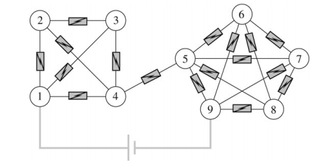
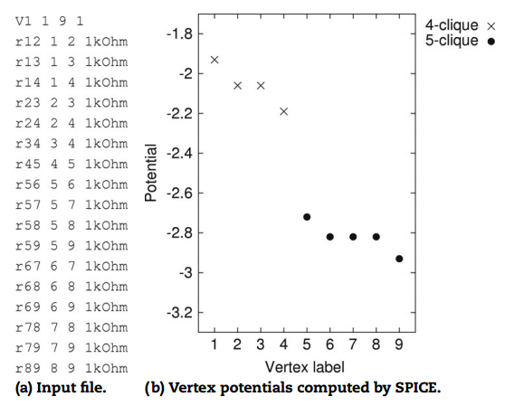
Voltage potential based
Another global clustering scheme
Resistors are weighted edges
Need to define source and sinks, to place a “battery”
Depends on how the voltage naturally divides itself along the network
CLUSTERS realized
REPEAT for several combinations of sources and sinks to find common groups, and finally use voting/bagging

Slide 10
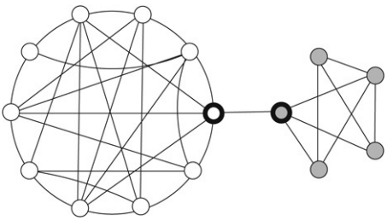
Local clustering
What happens in one area usually has no relation to something far away
Illustrated by this graph for random walk
Probability of crossing over is pretty low → 2 distinct clusters
Use this idea to limit the search “radius” for SimRank based methods
i.e. do not need to conduct exhaustive comparison of all nodes

Slide 11
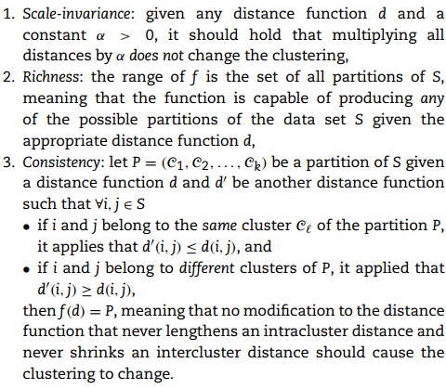
Comparison and Bench Marking
Need standard rules to compare between clusters and judge which is right
There are fairly general standards
I plan to use this to judge how well my clustering performs for my research project

Slide 12
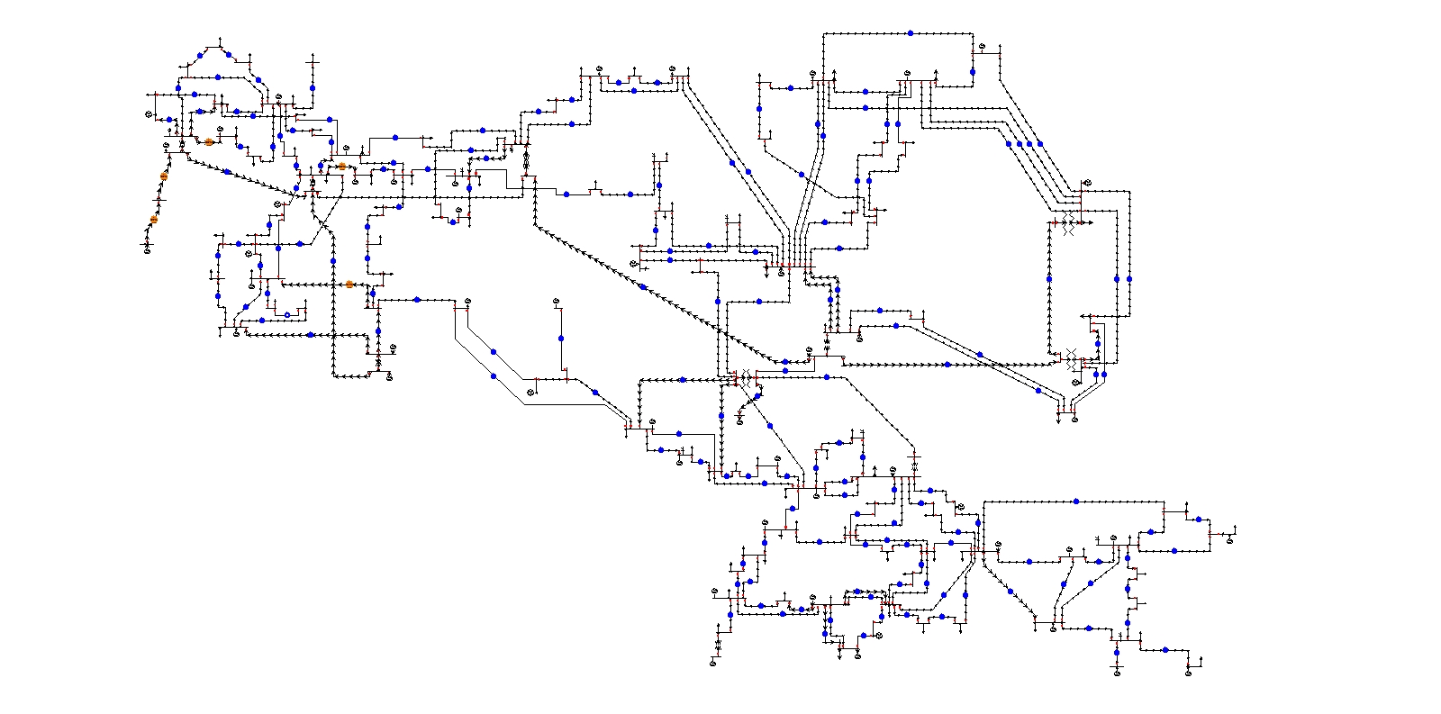
My research project
Application to power system data
Network shown above
How does this dictate transient behavior?
Comparison of differential algebraic models with graph topology
IEEE 118-bus test network

Slide 13
ddddddd
Network connectivity information is embedded in matrix K

Slide 14
Any questions?
Thank you for listening!

